Slide 1
JAVA 8 Introduction
Presented by Lingda tang

Slide 2
Lambda Expression
The syntax for a lambda expression looks like this:
( paramlist ) -> { statements }
One simple, very traditional example:
Runnable r = () -> System.out.println("Hello World");

Slide 3
When lambda can be used
The lambda must appear where an instance of an interface type is expected.
The expected interface type should have exactly one mandatory method.
The expected interface method should have a signature that exactly matches that of the lambda expression.
Developers use the term single abstract method (or SAM) type to refer to the interface type that the lambda is converted into

Slide 4
@FunctionalInterface
@FunctionalInterface
public interface Sloppy{
void slop();
}
Sloppy f = () -> System.out.println(“lambda interface”);

Slide 5
Method Reference
(MyObject myObj) -> myObj.toString()
This will be autoconverted to an implementation of a @FunctionalInterface that has a single nondefault method that takes a single MyObject and returns String
MyObject::toString

Slide 6
Functional Programming
java.util.function
R apply(T t) – Compute the result of applying the function to the input argument.
default ‹V› Function‹T,V› – Combine with another function returning a function which performs both functions.
Function<String, Integer> atoi = s -> Integer.parseInt(s);
atoi.apply(“123”);

Slide 7
Functional Programming
Two paramters
@FunctionalInterface
public interface BiFunction<T, U, R> {
R apply(T t, U u);
}
BiFunction<Integer,Integer,Integer> sum = (t1, t2) -> t1+t2;

Slide 8
Repeating annotations
Step 1: Declare a Repeatable Annotation Type
@Schedule(dayOfMonth="last")
@Schedule(dayOfWeek="Fri", our="23")
public void doPeriodicCleanup() { ... }
@Alert(role="Manager")
@Alert(role="Administrator")
public class unauthorizedAccessException extends SecurityException { ... }
@Repeatable(Schedules.class)
public @interface Schedule {
String dayOfMonth() default "first";
String dayOfWeek() default "Mon";
int hour() default 12;
}
public @interface Schedules {
Schedule[] value();
}
Step 2: Declare the Containing Annotation Type

Slide 9
Better Type Inference
Help me with this…

Slide 10
Extended Annotations Support
Now, it is possible to annotate mostly everything:
local variables
generic types
super-classes
implementing interfaces
method’s exceptions declaration
The ElementType.TYPE_USE and ElementType.TYPE_PARAMETER are two new element types to describe the applicable annotation context

Slide 11
Parameter names
Old Ages
Java developers are inventing different ways to preserve method parameter names in Java byte-code and make them available at runtime.
Nowadays
Java 8 bakes this demanding feature into the language (using Reflection API and Parameter.getName() method) and the byte-code (using new javac compiler argument –parameters).

Slide 12
Optional NullPointerException
Google Guava has made its effort.
Java 8 now takes the place~
Optional is just a container: it can hold a value of some type T or just be null. It provides a lot of useful methods so the explicit null checks have no excuse anymore.

Slide 13
Streams
Introduce real-world functional-style programming into the Java.
This is by far the most comprehensive addition to Java library intended to make Java developers significantly more productive by allowing them to write effective, clean, and concise code.

Slide 14
New Date-Time API
Date and time manipulation is being one of the worst pain points for Java developers. The standard java.util.Date followed by java.util.Calendar hasn’t improved the situation at all (arguably, made it even more confusing).
Joda-Time was good but we no longer need it.

Slide 15
Nashorn JavaScript engine
Allow developing and running certain kinds of JavaScript applications on JVM. Nashorn JavaScript engine is just another implementation of javax.script.ScriptEngine and follows the same set of rules, permitting Java and JavaScript interoperability

Slide 16
Base64
the support of Base64 encoding has made its way into Java standard library with Java 8 release

Slide 17
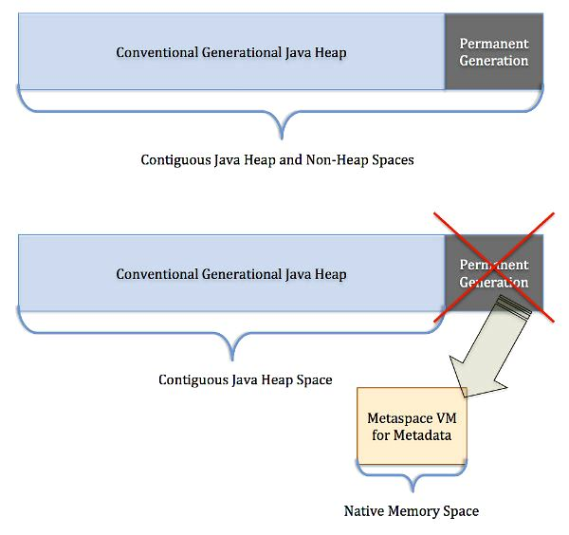
New Features in Java runtime (JVM)
The PermGen space is gone and has been replaced with Metaspace (JEP 122). The JVM options -XX:PermSize and –XX:MaxPermSize have been replaced by -XX:MetaSpaceSize and -XX:MaxMetaspaceSize respectively.

Slide 18
RxJAVA
Reactive Extensions is a library for composing asynchronous and event-based programs using observable sequences. This allows you to use functional prose to write consolidated and readable code which makes asynchronous processing easier to reason about.

